Slide 1
Flume Sources, Channels and Sinks

Slide 2
Sources
Avro Source
Thrift Source
Exec Source
JMS Source
Converter
Spooling Directory Source
Event Deserializers
LINE
AVRO
BlobDeserializer
Taildir Source
Twitter 1% firehose Source (experimental)
Kafka Source
NetCat Source
Sequence Generator Source
Syslog Sources
Syslog TCP Source
Multiport Syslog TCP Source
Syslog UDP Source
HTTP Source
JSONHandler
BlobHandler
Stress Source
Legacy Sources
Avro Legacy Source
Thrift Legacy Source
Custom Source
Scribe Source

Slide 3
Channels
Memory Channel
JDBC Channel
Kafka Channel
File Channel
Spillable Memory Channel
Pseudo Transaction Channel
Custom Channel
Flume Channel Selectors
Replicating Channel Selector (default)
Multiplexing Channel Selector
Custom Channel Selector

Slide 4
Sinks
HDFS Sink
Hive Sink
Logger Sink
Avro Sink
Thrift Sink
IRC Sink
File Roll Sink
Null Sink
HBaseSinks
HBaseSink
AsyncHBaseSink
MorphlineSolrSink
ElasticSearchSink
Kite Dataset Sink
Kafka Sink
Custom Sink

Slide 5
Exec Source
Exec source runs a given Unix command on start-up and expects that process to continuously produce data on standard out.

Slide 6
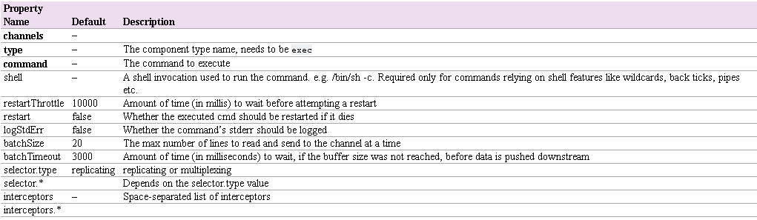
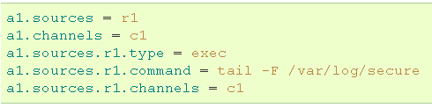
Exec Source

Slide 7
Spooling Direxctory Source
This source lets you ingest data by placing files to be ingested into a “spooling” directory on disk.
This source will watch the specified directory for new files, and will parse events out of new files as they appear.
The event parsing logic is pluggable.
After a given file has been fully read into the channel, it is renamed to indicate completion (or optionally deleted).

Slide 8
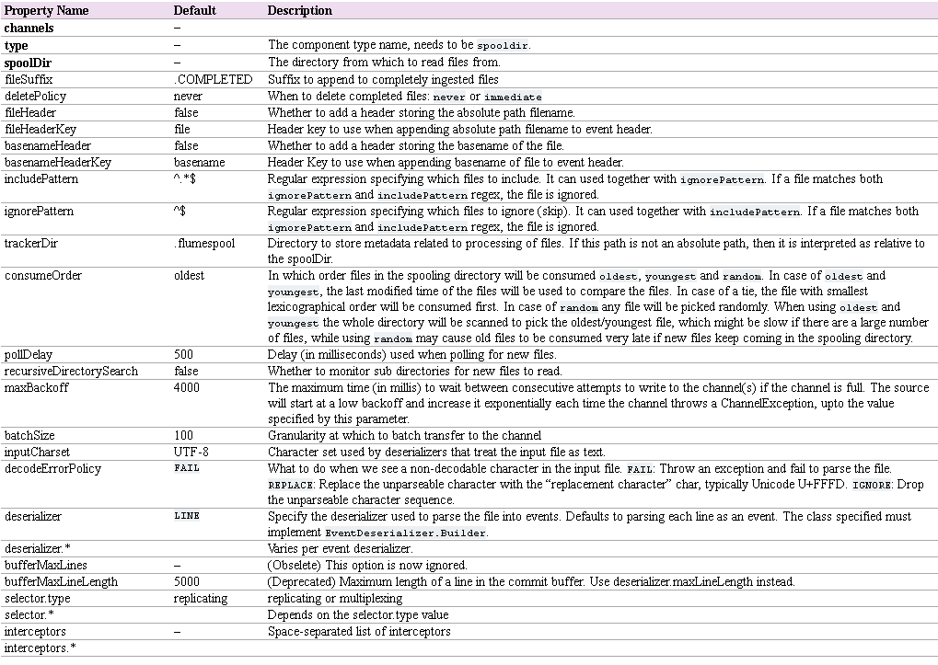
Spooling Directory Source

Slide 9
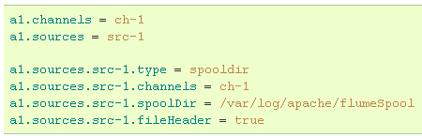
Spooling Directory Source

Slide 10
Sequence Generator Source
A simple sequence generator that continuously generates events with a counter that starts from 0, increments by 1 and stops at totalEvents.
Retries when it can’t send events to the channel.
Useful mainly for testing.

Slide 11
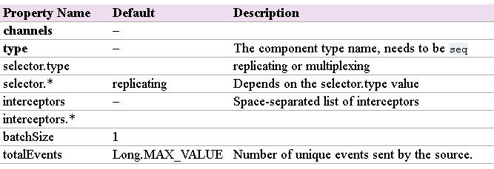

Sequence Generator Source

Slide 12
Sequence Generator Source
A simple sequence generator that continuously generates events with a counter that starts from 0, increments by 1 and stops at totalEvents.
Retries when it can’t send events to the channel.
Useful mainly for testing.

